Slide 1
LINEAR regression II Generalised Linear Models
Alejandro Ordonez
Assistant Professor - Department of Bioscience
Section for Ecoinformatics & Biodiversity
Center for Biodiversity Dynamics in a Changing World (BIOCHANGE)

Slide 2
Generalised LINEAR regressions What we will talk about today
Difference between GLM and GLMMs.
Parts of a GLMM.
Logistic regressions.
Principles, assessing model performance, model selection
Poisson regressions.
Principles, assessing model performance, model selection

Slide 3
Any questions?
Ready to start?

Slide 4
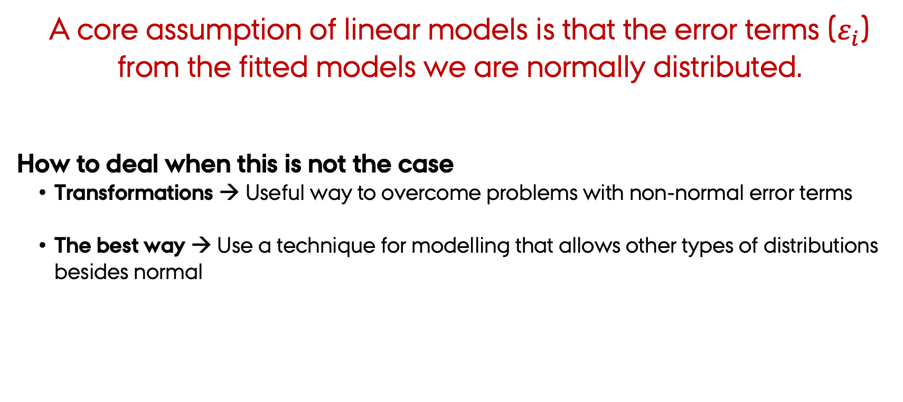
Generalised Linear Models (GLMM)
A core assumption of linear models is that the error terms ($ε_{i}$) from the fitted models we are normally distributed.
How to deal when this is not the case
Transformations → Useful way to overcome problems with non-normal error terms
The best way → Use a technique for modelling that allows other types of distributions besides normal
Generalised Linear Models

Slide 5
Generalised Linear Models (GLMM) Two important points
GLMM are linear models by definition
A linear combination of predictors describes the relation between predictors.
Many elements of simple regressions can be translated to GLMM.
GLMM are parametric models!
We assume that error terms follow a specific distribution
That distribution is NOT NORMAL!!!
These distributions are of the exponential family.

Slide 6
Generalised Linear Models (GLMM) Its’ parts
Systematic component
represent the predictors X
Random component
defines the probability distribution of the response variable Y
$$y_{i}=g_{\left(μ\right)}=β_{0}+β_{1}X_{1}+β_{2}X_{2}+…+β_{n}X_{n}+ε_{i}$$
Link function
the expression linking the expected value of the response variable Y to predictors X
Error

Slide 7
Generalised Linear Models (GLMM) The random part
As in simple linear regressions, Y is the random variable → hence the random part refers to Y
As a random variable, it can be described by a probability distribution
Gaussian
Continuous variables
Not bounded
Binomial
Probability
Success/Failure
Bounded (0/1)
Poisson
Counts
Not bounded
but discrete
The random variable distribution defines which is the best link function to use

Slide 8
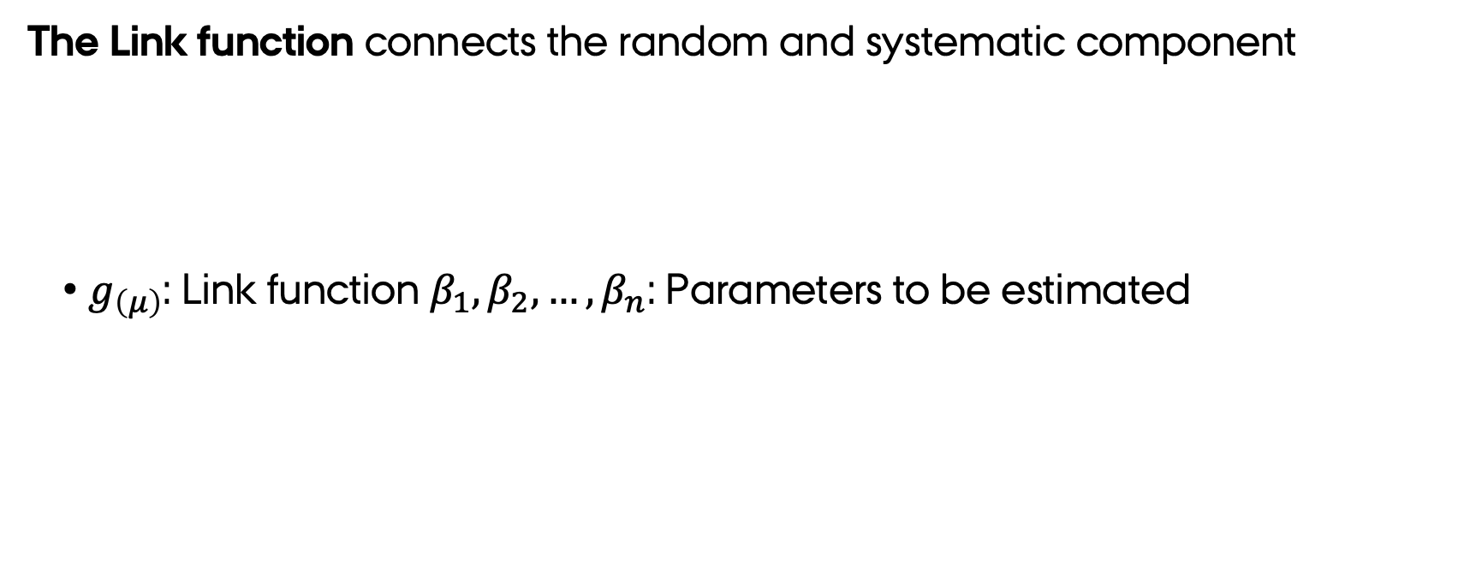
Generalised Linear Models (GLMM) The link function
The Link function connects the random and systematic component
$g_{\left(μ\right)}$: Link function $β_{1},β_{2},…,β_{n}$: Parameters to be estimated
$$g_{\left(μ\right)}=β_{0}+β_{1}X_{1}+β_{2}X_{2}+…+β_{n}X_{n}$$
The link function is the translator that links the predictors and the response variable

Slide 9
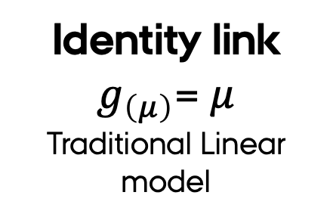
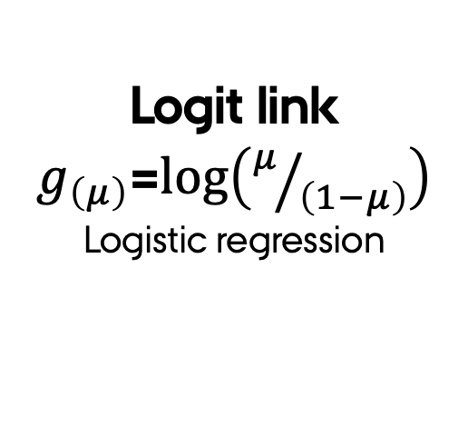
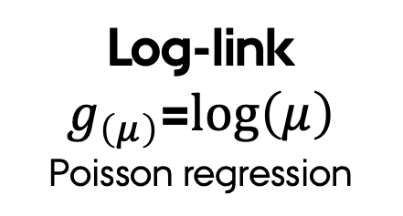
Generalised Linear Models (GLMM) The link function
Link function transform the relation between Y and X so that it can be evaluated as a linear model
continuous responses
binary or probability
count responses
Identity link
$g_{\left(μ\right)}$= $μ$
Traditional Linear model
Logit link
$g_{\left(μ\right)}$=$log\left(μ/{\left(1−μ\right)}\right)$
Logistic regression
Log-link
$g_{\left(μ\right)}$=$log\left(μ\right)$
Poisson regression

Slide 10
Generalised Linear Models Types we will discuss
Logistic regression
Response variable
Binary → Pres/Abs or Probability
What is modelled:
Probability that Y=1 given X
Error model:
Binomial
Poisson regression
Response variable
Counts → Discrete numbers
What is modelled:
Mean Count of Y given X
Error model:
Poisson

Slide 11
So far so good?
Any questions?
Ready to continue?

Slide 12
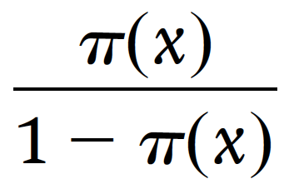
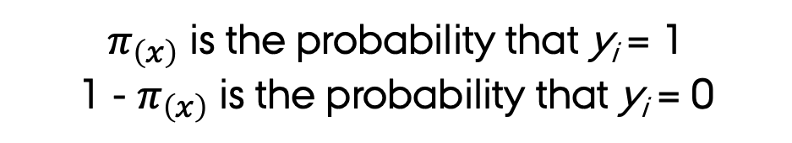
Generalized Linear Models Logistic regressions
We start by calculating the odds that an event occurs as:
The Logit transformation
This is how can we make proportions or probabilities to vary between -∞ and ∞?
$π_{\left(x\right)}$ is the probability that y_{i} = 1
1 - $π_{\left(x\right)}$ is the probability that y_{i} = 0

Slide 13
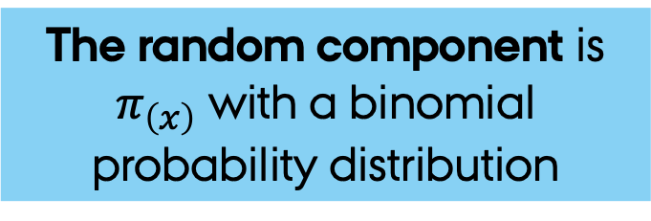

Logistic regressions - Its’ parts
The random component is $π_{\left(x\right)}$ with a binomial probability distribution
The systematic component is the continuous predictor x_{i}
The logit link function links the expected value of $π_{\left(x\right)}$ to the predictor(s)

Slide 14
Generalized Linear Models Poisson regressions
In biology we usually have discrete units that is the number of something!
Problem-1: Counts follow a Poisson distribution
Which is a violation of normal regressions assumptions.
Problem-2: in a Poisson distribution the mean (μ=λ) and variance (𝜎=λ) are the same
Which is a violation of independence of variance as the variance increases with the mean!!

Slide 15
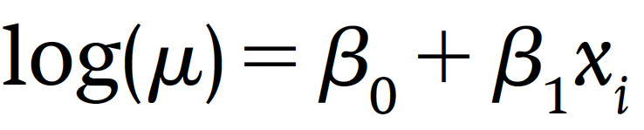
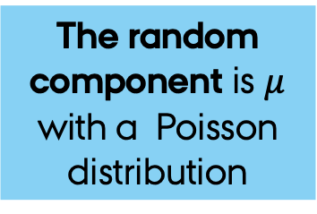
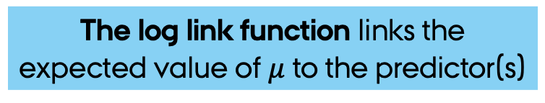
Poisson regressions - Its’ parts
A solution to these two (2) problems is to use a GLM with a Poisson error term and a log link function
The systematic component is the continuous predictor x_{i}
The random component is $μ$ with a Poisson distribution
The log link function links the expected value of$μ$ to the predictor(s)

Slide 16
So far so good?
Any questions?
Ready to continue?

Slide 17
Logistic regressions - Assumptions
The same as a linear model
Independence of observations
Little or no multicollinearity among the independent variables.
Linearity of independent variables and the link function…
However, this means No real Linearity → response is a logistic function of the predictors [which is an exponential function]
but…
Errors are binomial distributed and non-homogenous!
Probability distribution that adequately describes the random component is binomial.

Slide 18
Logistic regressions - Assumptions
Normal Distribution of Stdz. Residuals.
Don’t bother!
Homoscedasticity
Equal Variance.
Don’t bother! as it is done in the raw residuals
For these diagnostics we only considered standardised residuals
Linearity.
Leverage & outliers.

Slide 19
Poisson regressions - Assumptions
The same as a linear model
Linearity → additive predictors
Independence of observations
Little or no multicollinearity among the independent variables.
but…
There is now homogeneity of variances
In a Poisson model the mean μ = 𝜎
Errors are Poisson distributed.
Probability distribution that adequately describes the random component is Poisson.

Slide 20
Poisson regressions - Assumptions
Homoscedasticity
Equal Variance.
Don’t bother! as it is done in the raw residuals
Normal Distribution of Stdz. Residuals.
Don’t bother!
For these diagnostics we only considered standardised residuals
Linearity.
Leverage & outliers.

Slide 21
Standardised residuals
What are Raw residuals?
Provides an indication of the absolute error of the prediction.
Difference between the observed and predicted value.
Some residuals will be negative and some will be positive.
What are Standardised residuals?
Measure of the strength of the difference between observed and expected values.
Raw residual divided by an estimate of the standard deviation of the residuals.
Standardizing as we discussed in the data exploration lecture.

Slide 22

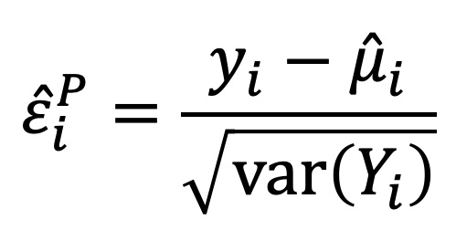
Standardised residuals
Pearson Residuals.
Scaling by the variance.
Avoid problems with changing variances
Deviance residuals.
Scaling by the deviance.
Better for model checking as these behave similar to residuals from a Gaussian linear regression
$${\hat{ε}}_{i}^{P}=\frac{y_{i}−{\hat{μ}}_{i}}{\sqrt{\text{var}\left(Y_{i}\right)}}$$
$${\hat{ε}}_{i}^{D}=\frac{ABS\left(y_{i}−μ_{i}\right)}{d_{i}}$$

Slide 23
So far so good?
Any questions?
Ready to continue?

Slide 24
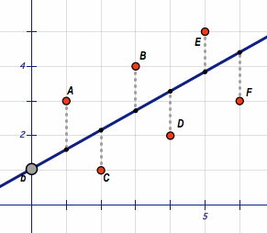
How the parameters are estimated GLMMs use Maximum likelihood!
Linear regressions:
Parameter estimates are determined using an Ordinary Least Squares method (OLS)
The goal in OLS is find a parameter that minimises the sum of squared residuals (Sum of squares)

Slide 25
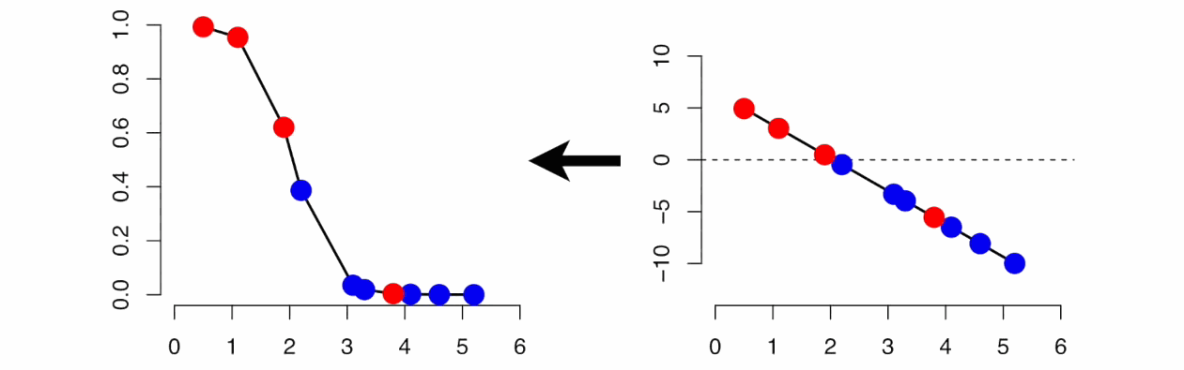
How the parameters are estimated GLMMs use Maximum likelihood!
Generalized Linear models:
Parameter estimates are determined using an Maximum Likelihood
Why? Because here residuals can be -∞ or ∞ so OLS does not work!
Probability/count
Link transformed
The likelihood is the multiplication of the estimated probabilities for a given reset of parameters
What is changing here is the βi, which makes the line change.
probability
Link transformed Y
Predictor
Predictor
For a expanded explanation check https://www.youtube.com/watch?v=BfKanl1aSG0

Slide 26
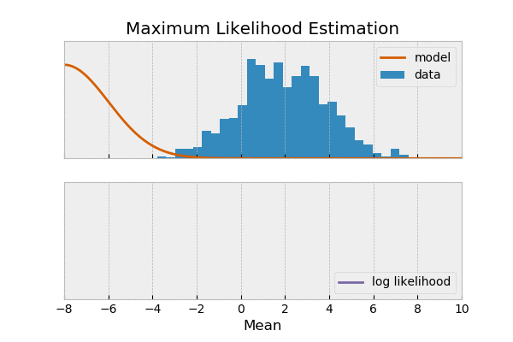
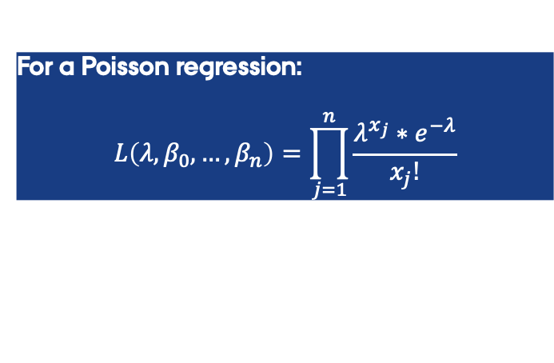
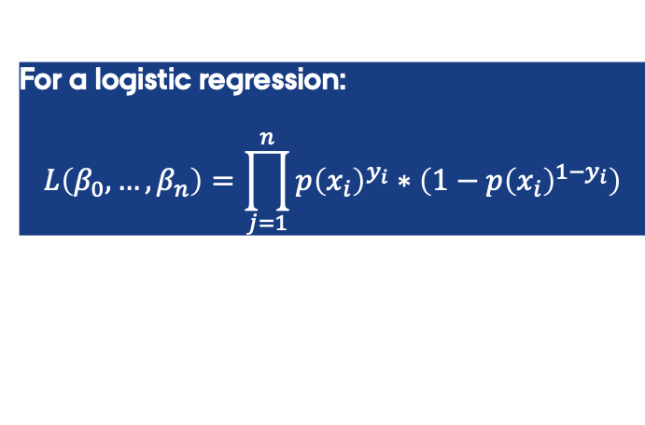
How the parameters are estimated GLMMs use Maximum likelihood!
It is simpler to think of this in finding the best parameters for the likelihood function
For a logistic regression:
$$L\left(β_{0},…,β_{n}\right)=\prod_{j=1}^{n}{p{\left(x_{i}\right)}^{y_{i}}∗\left(1−p{\left(x_{i}\right)}^{{1−y}_{i}}\right)}$$
For a Poisson regression:
$$L\left(λ,β_{0},…,β_{n}\right)=\prod_{j=1}^{n}{\frac{λ^{x_{j}}∗e^{−λ}}{x_{j}!}}$$
For a expanded explanation check https://www.youtube.com/watch?v=BfKanl1aSG0

Slide 27
So far so good?
Any questions?
Ready to continue?

Slide 28
Logistic regressions odds ratio and reg. coefficients
Odds ratios show the changes in the odds of an outcome for an increase in one unit of X.
As these β_{i} have a range of variation (90%-CI) the Odd ration also does
Odds ratio measure of how the changes of having a success changes with a one unit change the predictor.
If one is included in this interval
The variable has no effect!

Slide 29
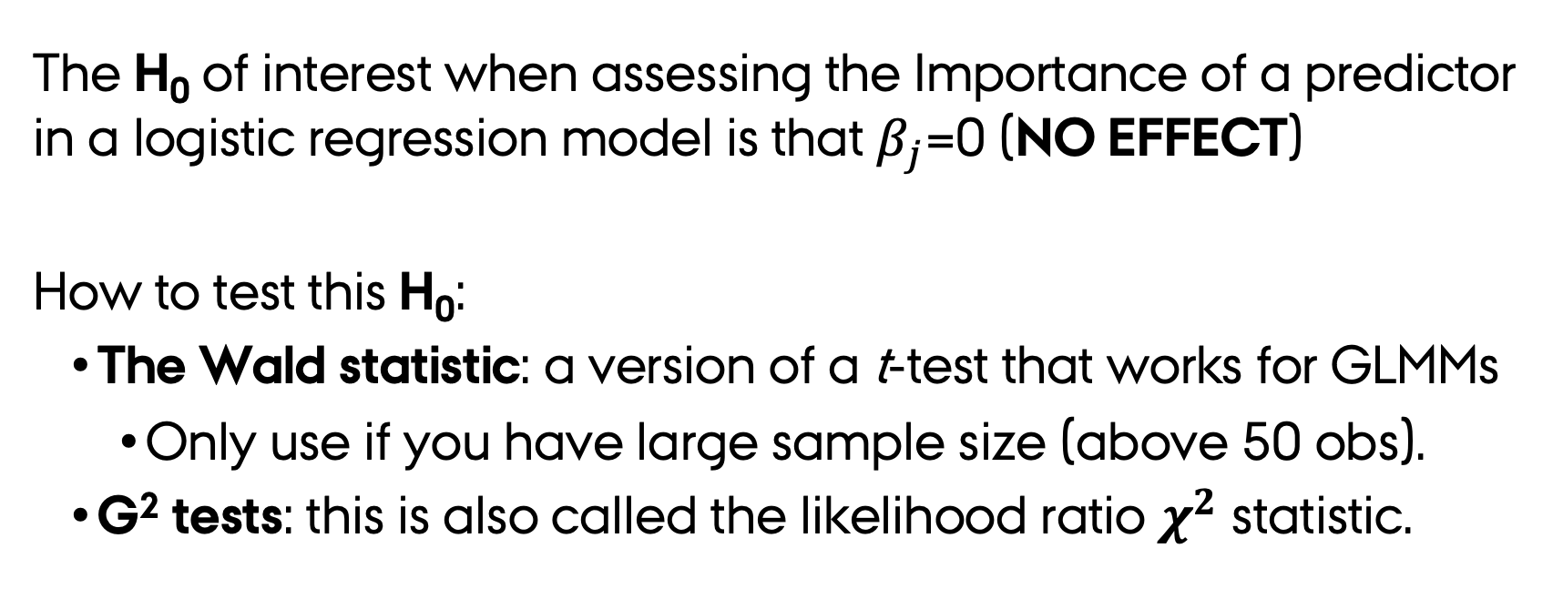
Logistic/Poisson regressions Importance of predictors
The H₀ of interest when assessing the Importance of a predictor in a logistic regression model is that $β_{j}$=0 (NO EFFECT)
How to test this H₀:
The Wald statistic: a version of a t-test that works for GLMMs
Only use if you have large sample size (above 50 obs).
G² tests: this is also called the likelihood ratio $χ^{2}$ statistic.

Slide 30
Logistic/Poisson regressions Importance of predictors
Here you can ask two questions:
Is the coefficient different form zero (0) → 𝛽_{𝑗}=0 (NO EFFECT)
The Wald statistic gives the answer to this question
Does the model perform better by having this variable?
G² tests gives the answer to this question

Slide 31
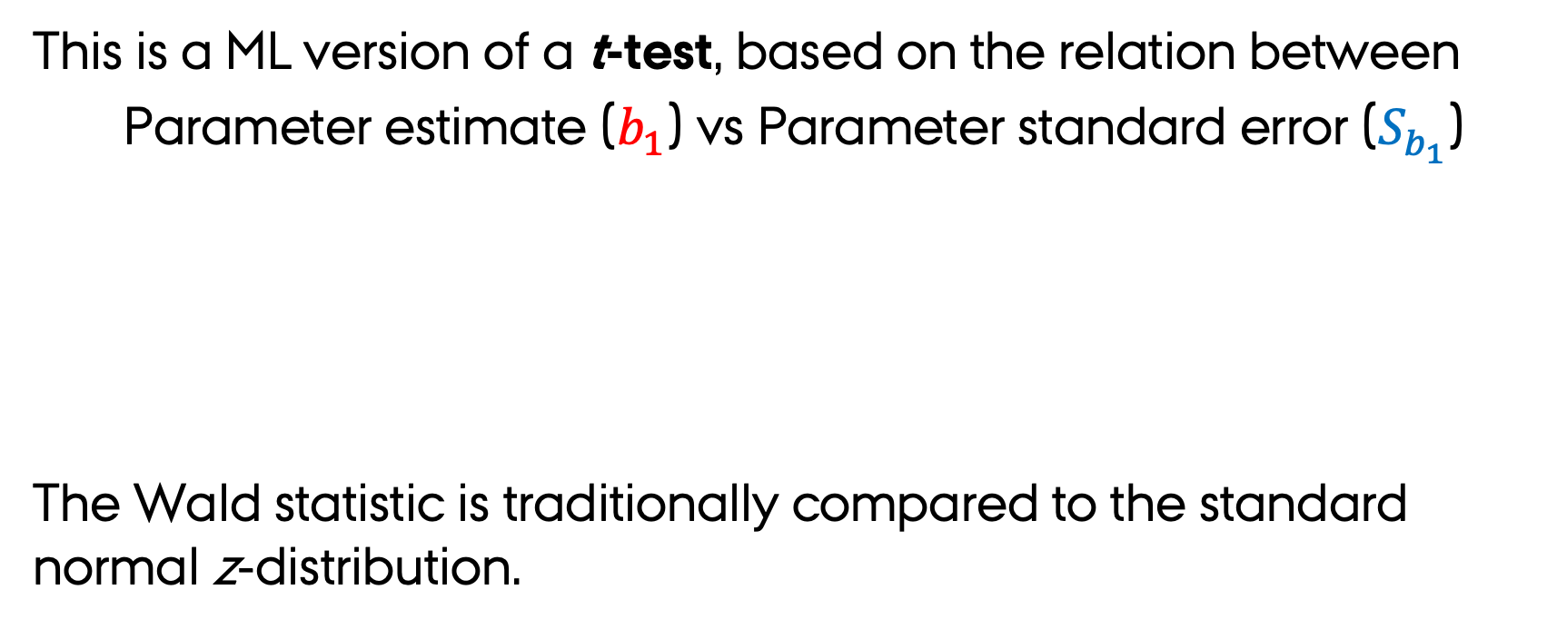
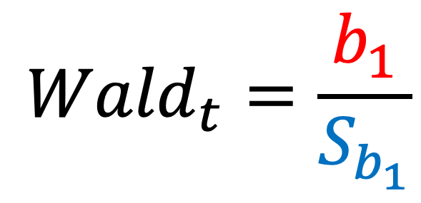
Logistic/Poisson regressions The Wald-t statistic
This is a ML version of a t-test, based on the relation between
Parameter estimate ($b_{1}$) vs Parameter standard error ($S_{b_{1}}$)
The Wald statistic is traditionally compared to the standard normal z-distribution.
$${Wald}_{t}=\frac{b_{1}}{S_{b_{1}}}$$

Slide 32
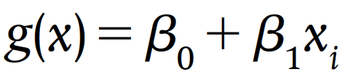
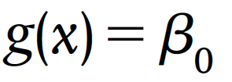
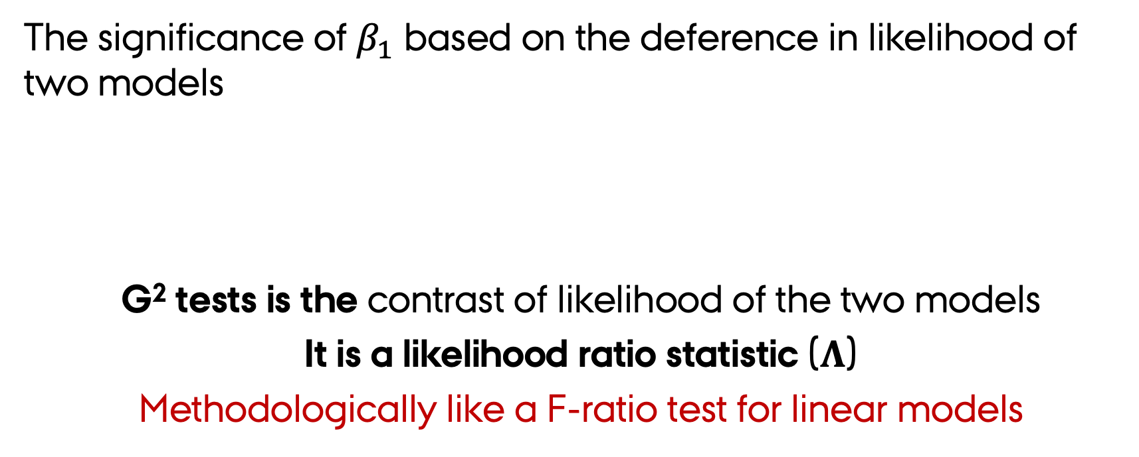
Logistic/Poisson regressions G² tests
The significance of $β_{1}$ based on the deference in likelihood of two models
G² tests is the contrast of likelihood of the two models
It is a likelihood ratio statistic ($Λ$)
Methodologically like a F-ratio test for linear models
A full model
A reduced model

Slide 33
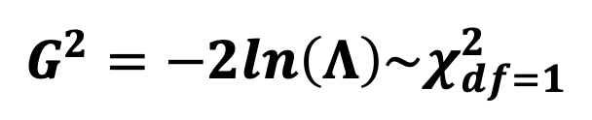

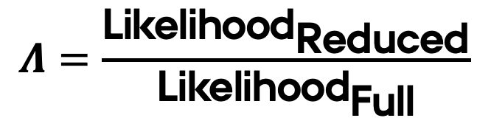

Logistic/Poisson regressions G² tests
The likelihood ratio statistic $\text{(}Λ\text{)}$ is the contrasts the likelihood of two models
Note these are Likelihood but R gives you Log-likelihoods!
$$Λ=\frac{{\text{Likelihood}}_{\text{Reduced}}}{{\text{Likelihood}}_{\text{Full}}}$$
A full model
A reduced model
The closer $Λ$is to one, $β_{1}$contributes little to the full model fit
$$G^{2}=−2ln\left(Λ\right)\sim χ_{df=1}^{2}$$

Slide 34
Logistic/Poisson regressions How good is my model?
GLMM have no R² or adjusted R² → How to define model Fit?
Deviance measures the unexplained variation for a given model and therefore is a measure of goodness-of-fit
> summary(fit)
Call:
glm(formula = num_awards ~ prog + math, family = "poisson", data = mydata)
...
(Dispersion parameter for poisson family taken to be 1)
Null deviance: 287.67 on 199 degrees of freedom
Residual deviance: 203.45 on 197 degrees of freedom
AIC: 385.51
Number of Fisher Scoring iterations: 6
Comparing the
Residual deviance
[current vs saturated model]
and
Null deviance
[current vs no predictor model]
Provides a measurement of goodness-of-fit similar to an R².

Slide 35
So far so good?
Any questions?
Ready to continue?

Slide 36
Poisson regressions The over dispersion problem
A key assumption of when modeling count data
The mean equals the variance.
BUT, In many cases variance > mean
This is called overdispersion.
Why can this happen?:
Omission of important factors
Why this is a problem?:
Regression coefficients to small
Inflated Type I error probabilities

Slide 37
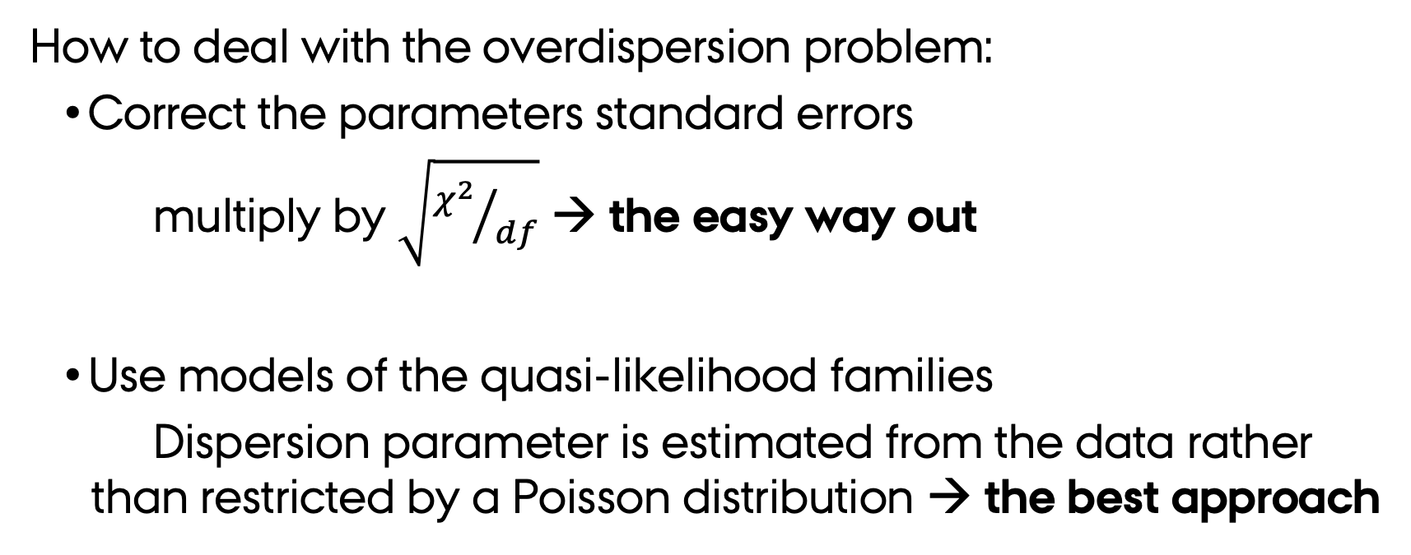
Poisson regressions The over dispersion problem
How to deal with the overdispersion problem:
Correct the parameters standard errors
multiply by $\sqrt{{χ^{2}}/{df}}$ → the easy way out
Use models of the quasi-likelihood families
Dispersion parameter is estimated from the data rather than restricted by a Poisson distribution → the best approach
Quasi-models are already implemented in R family=“quasipoisson” family=“quasibinomial”

Slide 38
Poisson regressions Zero inflation
How to deal with the overdispersion problem?:
Use a negative binomial model → loosens the restrictive assumption that the variance is equal to the mean.
Poisson regressions are a generalization of negative binomial models.

Slide 39
Beyond Poisson regressions Dealing with too many zeros
Zero Inflated Poisson models assume that
Some zeros occurred by a Poisson process → think true absences.
Others not eligible to have the event occur → think sampling error.
This means there are two processes at work! → The tricky part is that either process can result in a 0 count
Zero Inflated models estimate "true zeros" and "excess zeros” simultaneously.

Slide 40
So far so good?
Any questions?
Ready to end?

Slide 41

Summary
$$y_{i}=g_{\left(μ\right)}=β_{0}+β_{1}X_{1}+β_{2}X_{2}+…+β_{n}X_{n}+ε_{i}$$
GLMM’s are linear models by definition
Consider the right model:
Probabilities [Logistic] vs. Counts → [Poisson] vs. Many zeros [Negative binomial]
Always test the assumptions to define
If the linear model you build is “statistically correct”
GLMM’s assumptions are the same as GLM → diff is the distribution of residuals
Remember that the results of a GLM need to be “back transformed” → they are given in the loglink function units
Always check for overdispersion by asking : is the residual deviance much greater than the residual degrees of freedom?

